Slide 1

C++ & DSA PLACEMENT COURSE
Khaiser Khanam

Slide 2


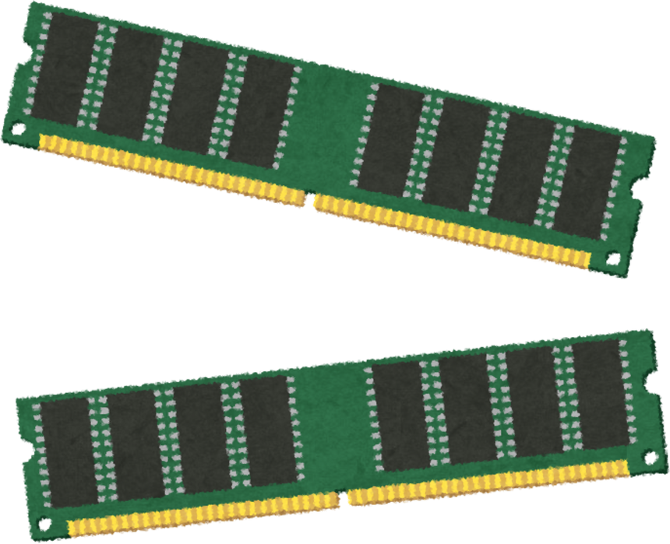
Data Types & Type Casting in C++

Slide 3
WHAT WE WILL LEARN?
Different Categories of Data Types
Modifiers
Typecasting
Data Type Limits
Homework

Slide 4
Data Types ke Main Categories
1. Primitive / Built-in Data Types
2. Derived Data Types
3. User-defined Data Types

Slide 5
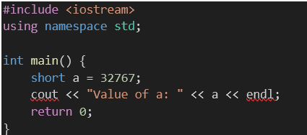
Homework
Question 1: Find the output
Agar a mein 1 aur add kiya jaaye toh kya hoga? Short data type ki range ke basis pe likhna.

Slide 6
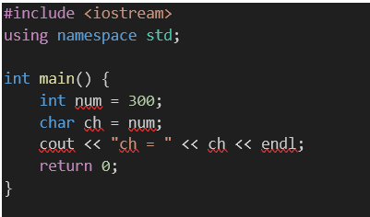
Homework
Question 2: Find the output
char ch = num; line pe kya warning milegi? Aur output mein kaunsa character print hoga? Reason explain karo binary conversion aur ASCII ke base par.

